Slide 1
Internet

Slide 2
In this Smart Lesson you will do the following:
State how the internet transmits information.
Describe the different signals that transmit information over the internet.

Slide 3
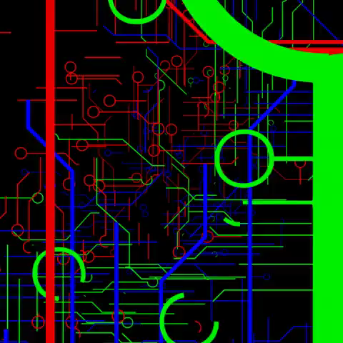
The internet uses waves to send information.
We can use different kinds of electromagnetic waves to send the information.
The main 3 ways we can transmit data utilize:
Electricity | The most common way used in most wired connections, relatively slow and inefficient.
Light | Used in Fibre optics to send information fast and efficiently.
Radio | Used to transmit wireless internet over shorter ranges.

Slide 4

We need to connect to a router in order to access the internet.
A router is a device which connects your computer or laptop to an internet server.
An internet server shares data and resources. They store websites and files so that people can view or download them on the internet.

Slide 5

When we send an email, request a file or want to view a webpage, the data is split into packets which each contain around 1500 bytes of information.
These packets of data are then sent down a packet-switching network. This network sends the packets down different pathways to ensure that they reach their destination.
These packets are reassembled when they reach their destination. This lets people read your email or download your file!

Slide 6
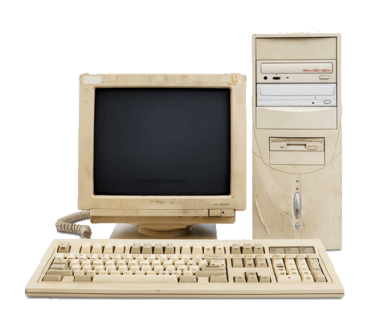
There are two types of signal that we use to connect to the internet.
These are analogue signals and digital signals.
Analogue signals were used for dial-up internet. These signals were sent over telephone cables.

Slide 7

A modem converts the digital signals from the computer into an analogue signal, in the form of an electrical signal.
These sounds were then transmitted down the telephone line. A signal from the internet would be sent back as an electrical signal and the modem would convert this into a digital signal which the computer could understand.

Slide 8

Analogue signals are not very efficient.
Only a little bit of information can be sent at once. This makes these connections very slow.
Dial-up internet also requires some connection time in order to connect to the telephone cables.

Slide 9
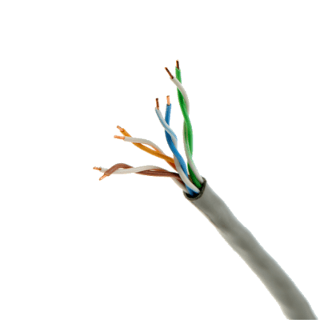
The telephone cables which analogue signal were sent along are twisted-pair copper wires.
These are made of a pair of insulated copper wires.

Slide 10

Most internet connections today use digital signals.
These signals are sent down coaxial cables.
We can send many signals down these cables at once. We do this by using carrier waves.

Slide 11
Carrier waves are electromagnetic waves that have a steady base frequency.
On a carrier wave we can impose information onto it by increasing the signal strength, varying the frequency or the wave phase.
This technique is called frequency division multiplexing, or FDM.

Slide 12
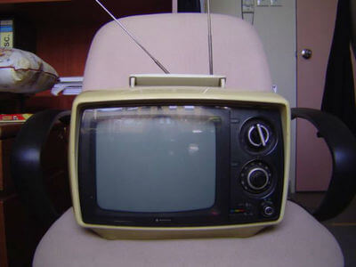

We can also request and send information on different carrier waves with different frequencies.
This allows us to send and request more information without them interfering with each other, resulting in more easy, efficient and faster transmission of information.

Slide 13
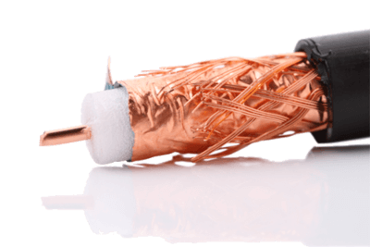
Digital signals are sent along coaxial cables.
These cables have a copper core which carries the signal. This core is surrounded by insulation, and then wrapped in a copper mesh. Finally, the entire cable is wrapped in an outer covering which protects the cable.
The copper mesh protects the signal from interference and stops the loss of signal strength.

Slide 14

When these signals are received, the different frequencies are sorted back into the different signals.
We call this process demodulation. This also uses a modem to convert the signals into a form which can be transmitted.

Slide 15
Digital signals transmit information much faster than analogue signals.
This is because more data can be sent at the same time.

Slide 16
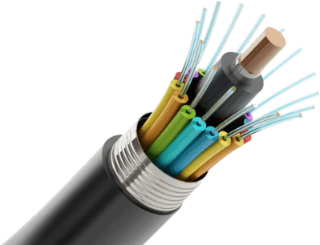
The National Broadband Network is a project to connect all major cities in Australia with optical fibres.
Optical fibres have a core of pure silica glass which laser pulses are sent down. This is surrounded by a cladding of a less dense glass, causing total internal reflection to occur.

Slide 17
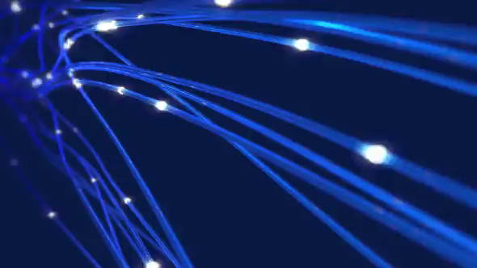
A signal sent down optical fibre moves at light speed.
There is also less signal loss.
The National Broadband Network will deliver ultrafast internet to 93% of Australia's population when it is completed. It is expected to be fully completed in 2021.

